Slide 1
Ventura County Waterworks District No. 17
Past, Present, and Future
Public Meeting at Ventura County Waterworks District No. 17 (Bell Canyon)
Michaela Brown, Director
Water and Sanitation Department
Ventura County Public Works Agency
June 7, 2017

Slide 2
District was Formed April 11, 1977
Notes:
Administration
County of Ventura Water and Sanitation Department is responsible for the management, operation, and maintenance of the water system.
The Ventura County Board of Supervisors (BOS) is the Board of Directors for the District.
A Citizens’ Advisory Committee (CAC) reviews all policy, budget, and water rate recommendation before they are recommended to the BOS.
CAC members are appointed by the BOS whose terms coincide with the County Supervisor.
Supervisorial District No. 2 appoints 4 CAC members
Supervisorial District No. 3 appoints 1 CAC member

Slide 3
Michaela Brown Director
Susan Pan Deputy Director
Eric Keller Deputy Director
Jean Fontayne Staff Services Manager
Derek Fouarge Billing Supervisor
David Hazen Water Superintendent
Andy Flores Water Supervisor
Sean Hanley Water Supervisor
District Staff – Who We Are

Slide 4

District Goals
Provide an uninterrupted, reliable water supply meeting water quality standards.
Sufficient funding through water rates to pay for
  Efficient O&M operations.
  Imported water costs.
  SCE charges.

Slide 5
District Financials
 | FY 2017 | FY 2018
Expenses | $2,519,000 | $2,842,000
Revenues | $2,135,000 | $2,306,000
Net (Gain/Loss) | ($384,000) | ($536,000)
Notes:
Budgets
Increased water sales 1.68 million 2017 to 11.97 million
Incrase of water sales of 8%, increase expenses 4%
Reserves $1.6 million by end of FY
The District operates as an enterprise fund and does not receive any tax revenues.
All expenses are paid by District customers through water rates and charges
Annual Operations and Maintenance budget is approximately $_______________.

Slide 6
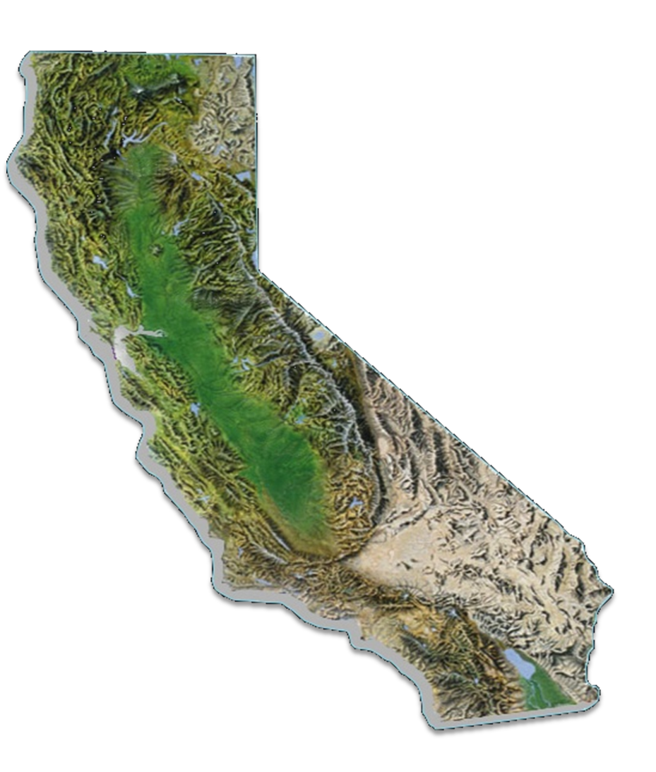
Where Does the Water Supply Come From?
Metropolitan Water District of Southern California (MWD)
Imports water from Northern California through
California State Water Project
Colorado River Aqueduct
Provides water supply to six (6) Southern Counties
District imports 100% of its water through the MWD, Calleguas Municipal Water District, and the city of Simi Valley where it is pumped over the Santa Susanna Pass to Bell Canyon.
San Luis Reservoir
Los Angeles Aqueduct
State Water Project
Colorado River Aqueduct

Slide 7
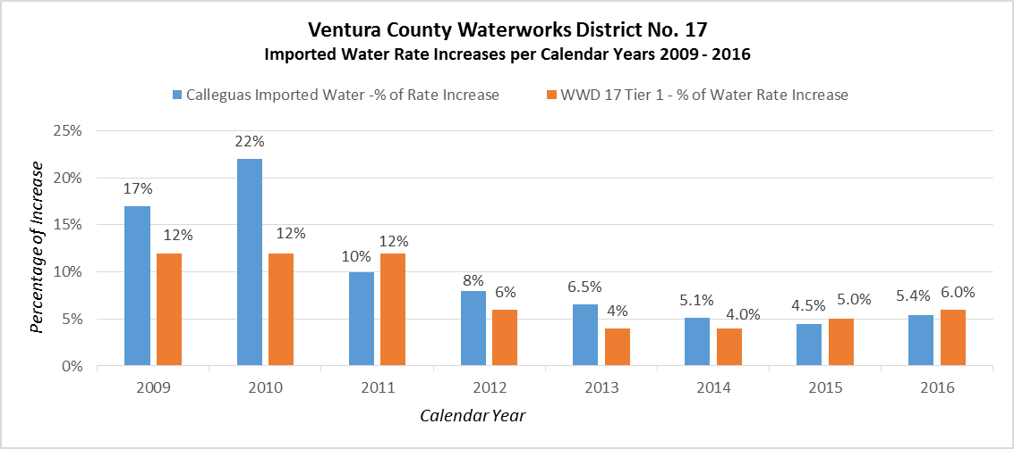
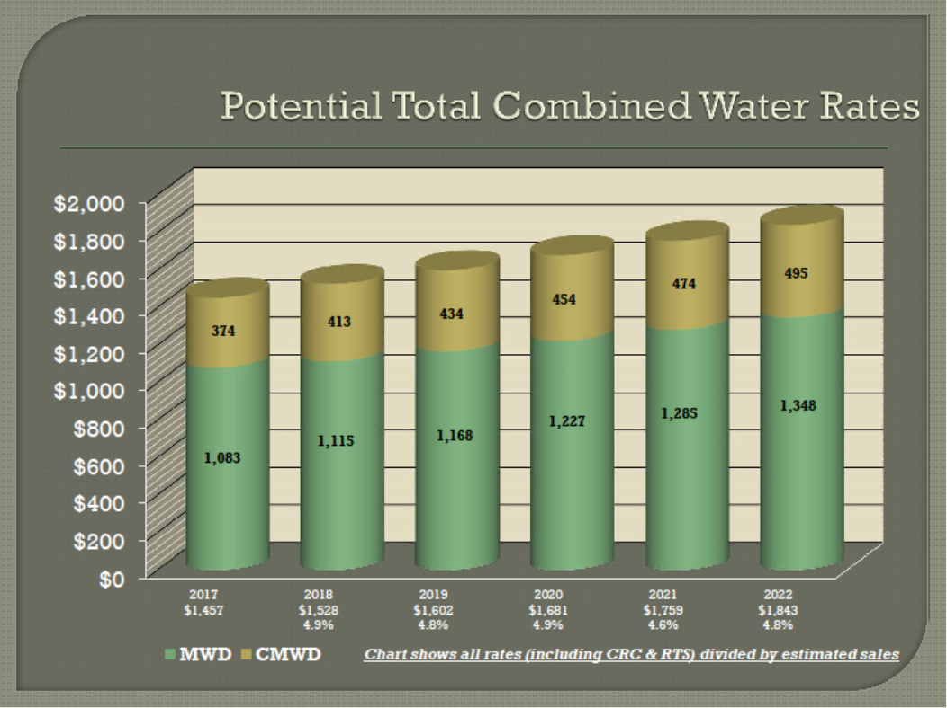
A Comparison of District and Calleguas Rate Increases 2009-2016
Projected Rate Increases from Calleguas 2017-2022

Slide 8

Cost-Cutting Measures
  Automatic Meter Reading
  Combined read areas
  Updating of the Billing System
  SCADA System
  Job consolidation
  Eliminated unnecessary travel/meetings
Notes:
Budgets
The District operates as an enterprise fund and does not receive any tax revenues.
All expenses are paid by District customers through water rates and charges
Annual Operations and Maintenance budget is approximately $_______________.

Slide 9

Why a Rate Increase? Principle Factors Include...
An Estimated ...
5% increase per year for wholesale water costs
3% to 5% increase per year in power (charges of pumping water from Simi Valley to the District (gas/electric), labor, and materials costs
$5.5 million needed for capital improvements between 2017 and 2021 to add, repair, or replace water system infrastructure, including possible reservoir
The Need to...
Maintain appropriate financial reserves.
Meet Prop 218 legal requirements

Slide 10
Proposed Timeline
Date | Action
July 12, 2017 | Present proposed rate alternatives to District’s Citizens’ Advisory Committee (CAC)
July 26, 2017 | Finalized rate proposal based on residential and CAC feedback
August 7, 2017 | Proposition 218 notices (45 days before Board of Supervisors Hearing)
September 26, 2017 or October 3, 2017 | Hearing before the Board of Supervisors
January 2018 | New rates implemented
Notes:
Will meet with other stakeholders such as:
CSD
BCA
And other inrested parties.

Slide 11

Questions?

