Slide 1
Citizens’ Advisory Committee Meeting
Waterworks District No. 19
Regular Meeting, August 15, 2019

Slide 2
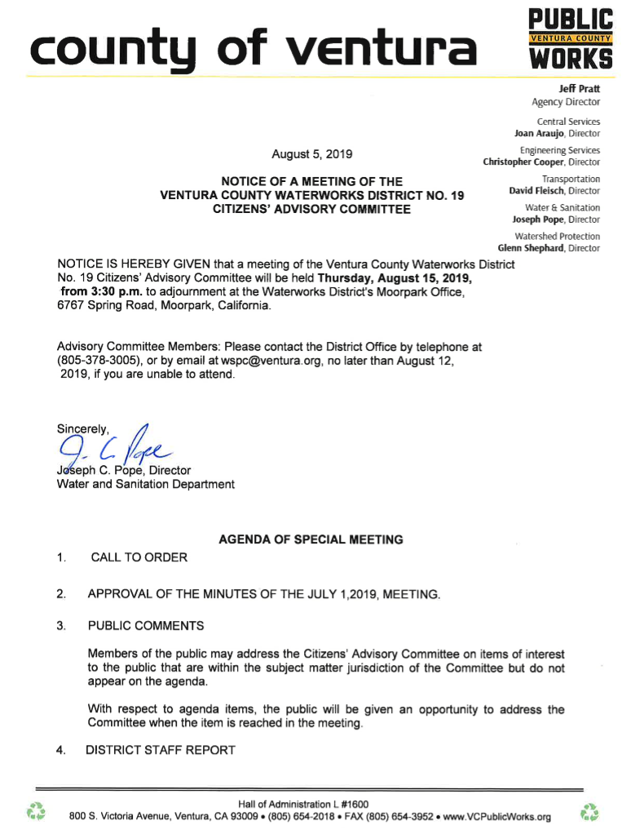
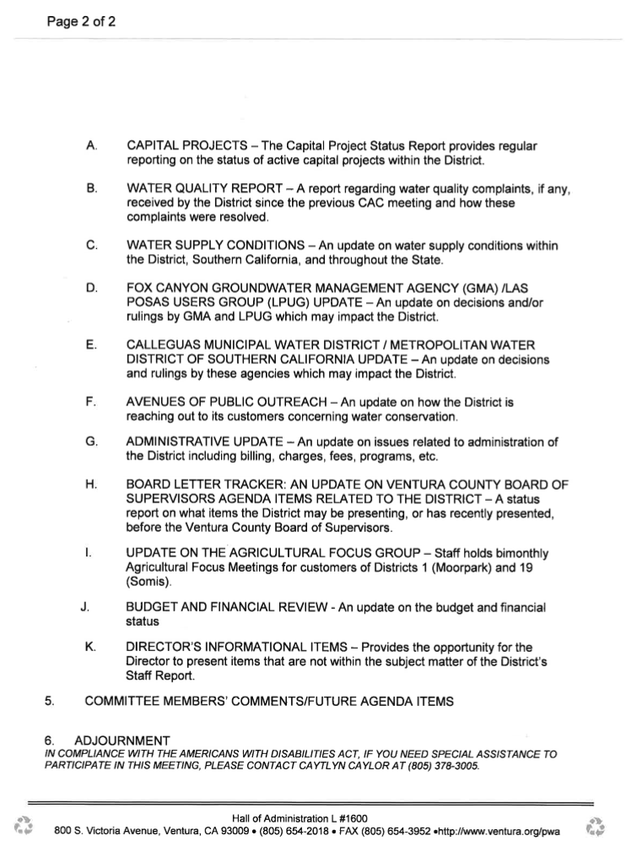

Slide 3
CALL TO ORDER
APPROVAL OF THE JULY 1, 2019 SPECIAL MEETING MINUTES
Vote: Yeas / Nays / Absence / Abstained
Notes:
MINUTES PROVIDED TO CAC VIA HANDOUT
Vote:
YES –
NO –
ABSCENSE –
ABSTAINED -

Slide 4
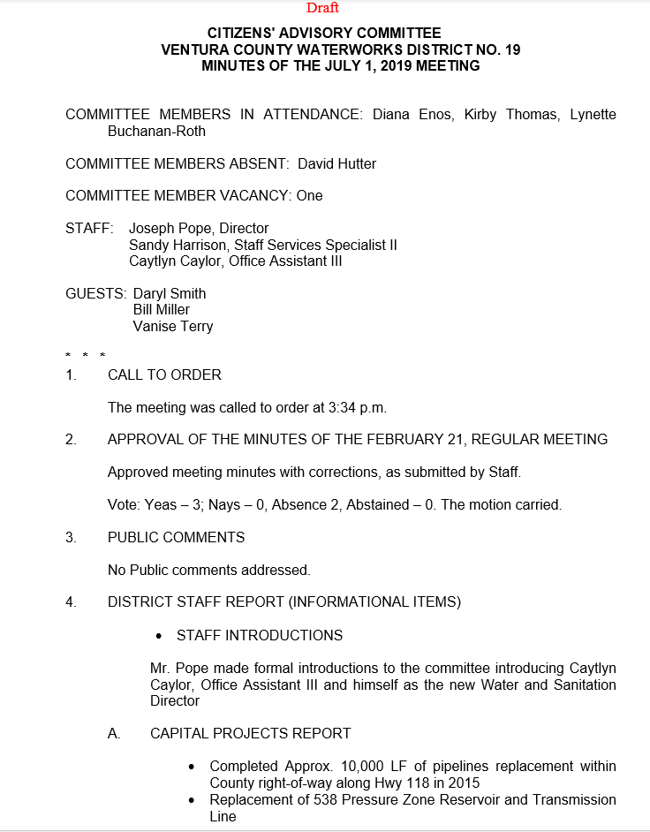
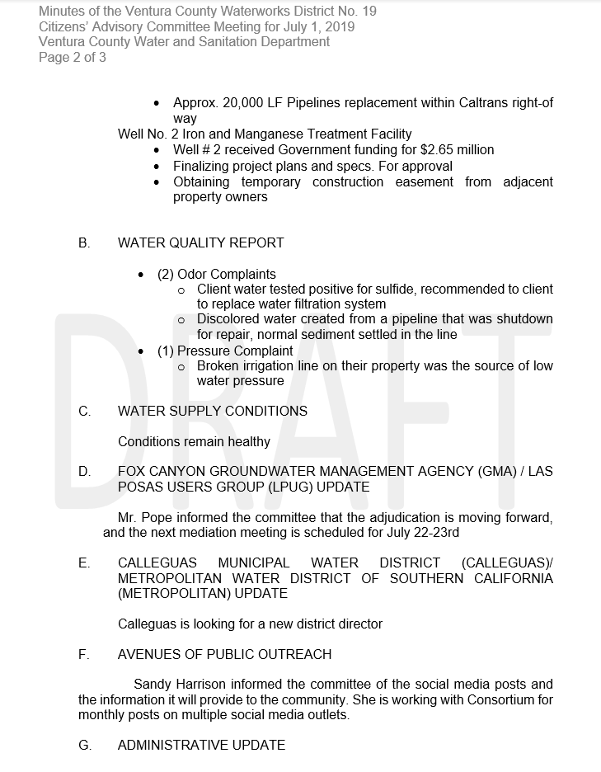

Slide 5
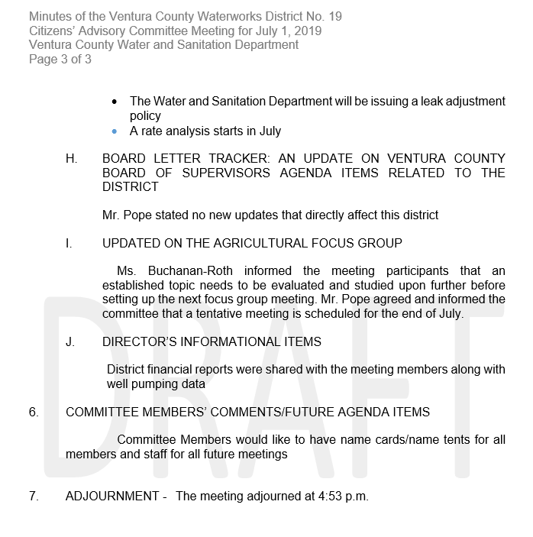

Slide 6
3. PUBLIC COMMENTS
Members of the public may address the Citizens’ Advisory Committee on items of interest to the public that are within the subject matter jurisdiction of the Committee but do not appear on the agenda.​
With respect to agenda items, the public will be given an opportunity to address the Committee when the item is reached in the meeting.​
Notes:
Public Comments:

Slide 7
4. DISTRICT STAFF REPORT
Notes:
Joe and Caytlyns introduction to CAC

Slide 8
A. CAPITAL PROJECTS
The Capital Project Status Report provides regular reporting on the status of active capital projects within the District.​
Notes:
NOTES FOR JP: Well 2 funding, 538 Reservoir, Preliminary engineering study & CEQA​
Greentree Booster pump station upgrade of controls

Slide 9
CAPITAL PROJECTS REPORT
Active Capital Projects | Project Mgr. ​ | Scheduled or Actual Dates​ |  |  |  | % Compl.​ | Remarks​
 | Design Eng. Contractor | Plan Approval | Contract Award | Constr. Start | Constr. Compl | Design / Constr.
District No. 19​ Well No. 2​ Iron and Manganese facility WS239898​ | S. Pan / M. Segui​ MBI;​ Padre & Assoc.;​ Oakridge​ | 06/19​ | 09/19​ ​ | 10/19​ | 10/20​ | 99/0​ | 7/2019- Advertising project.​ 6/2019- Obtained State budget appropriation to fund project. Finalizing project plans and specs. package for approval. Obtaining temporary construction easement from adjacent property owners.​ 3/2019- Prepared and submitted memo and supporting documents to the Financial Planning Committee, scheduled FPC meeting for borrowing from COV Revolving Credit Agreement fund.​ 1/2019- Met with CEO Analyst for borrowing from COV General Fund Loan, preparing the supporting documents for the Finance Committee and BOS meetings​ ​
District No. 19​ 538 Pressure Zone​ 1.0 MG Reservoir & 1,100 LF 12-inch Transmission Line Replacement​ WS239906 &​ WS239907​ | S.Pan / ESD​ | 3/21​ | 6/21​ | 7/21​ | 6/22​ | 0/0​ | 6/2019- Surveyed existing ROW and staked existing pipeline across Arroyo Las Posas; KJ consultant performing preliminary engineering design.​ 3/2019- KJ Consultant contract for CEQA and 30% design services approved by PWA Director, issued Notice to Proceed to KJ.​ 1/2019- KJ Consultant contract for CEQA and 30% design services for PWA Director approval 1/2019​ ​
District No. 19 Pipe Replacement @ CalTrans R/W ​ WS239904​ | S. Pan​ Padre & Assoc.;​ AECOM​ | 07/20​ | 10/20​ | 11/20​ | 10/21​ | 90/0​ | 6/2019 – Investigating County financing options: revolving Credit Agreement.​ 1/2015 – Project is on hold pending District 19 financial planning.​ 3/2014 - AECOM submitted 95% plans to all review Agencies including Cal Trans, Calleguas MWD, VCWPD, and WWD#19​ ​
Notes:
Low Bid Details:​
Well No. 2​
Iron and Manganese facility - $2,650,000​
(Total Project cost: $2.65 mil; State budget appropriation; Dist)​
Transmission Line Replacement - $2,750,000​
Pipe Replacement @ CalTrans R/W - $3,000,000​
​
​
​

Slide 10
B. WATER QUALITY REPORT
A report regarding water quality complaints, if any, received by the District since the previous CAC meeting and how these complaints were resolved. ​
Notes:
Report Requested 8/12/19

Slide 11
C. WATER SUPPLY CONDITIONS
An update on water supply conditions within the District, Southern California, and throughout the State.

Slide 12
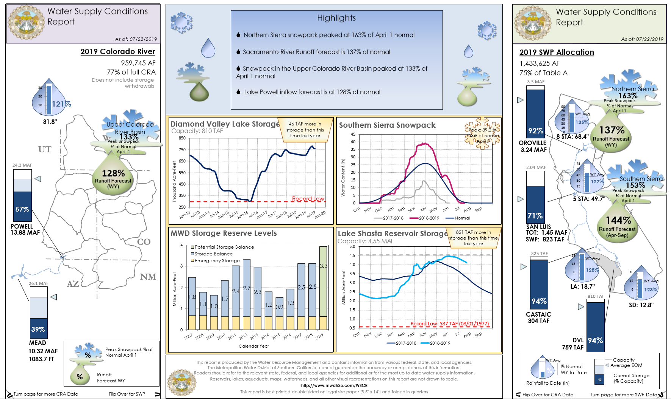

Slide 13
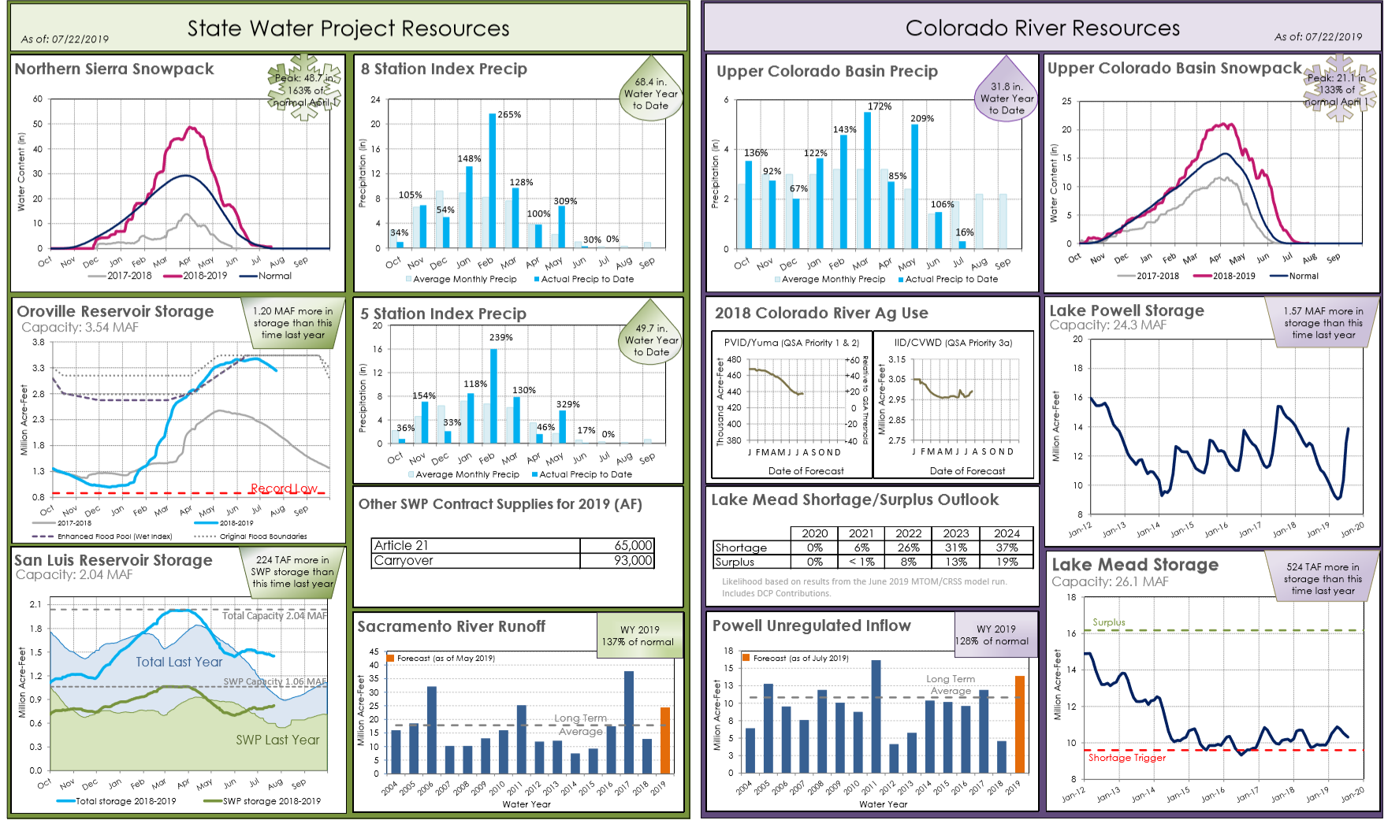

Slide 14
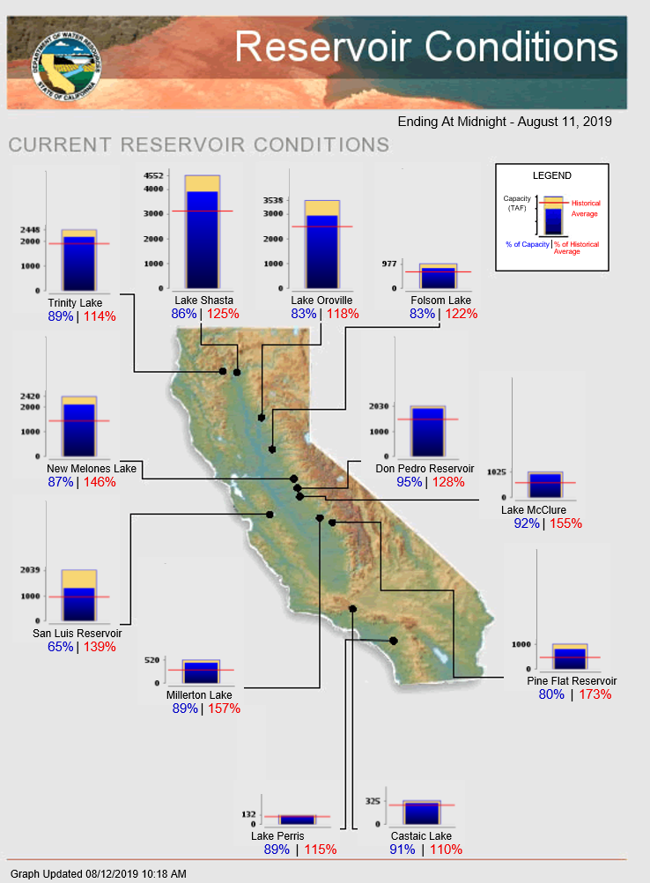

Slide 15
D. FOX CANYON GROUNDWATER MANAGEMENT AGENCY (GMA) / LAS POSAS USERS GROUP (LPUG) UPDATE
An update on decisions and/or rulings by GMA and LPUG which may impact the District.
Notes:
Adjudication FAQ sheeting on next slide

Slide 16
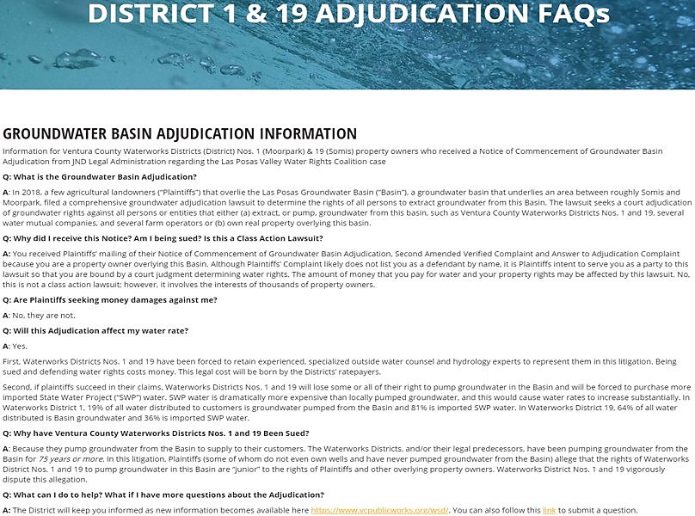

Slide 17
E. CALLEGUAS MUNICIPAL WATER DISTRICT /​ METROPLITAN WATER DISTRICT OF SOUTHERN CALIFORNIA UPDATE
An update on decisions and rulings by these agencies which may impact the District.
Notes:
Notes??

Slide 18
F. AVENUES OF PUBLIC OUTREACH​
An update on how the District is reaching out to its customers concerning water conservation. ​
Notes:
Consortium Media: weekly outreach posts

Slide 19
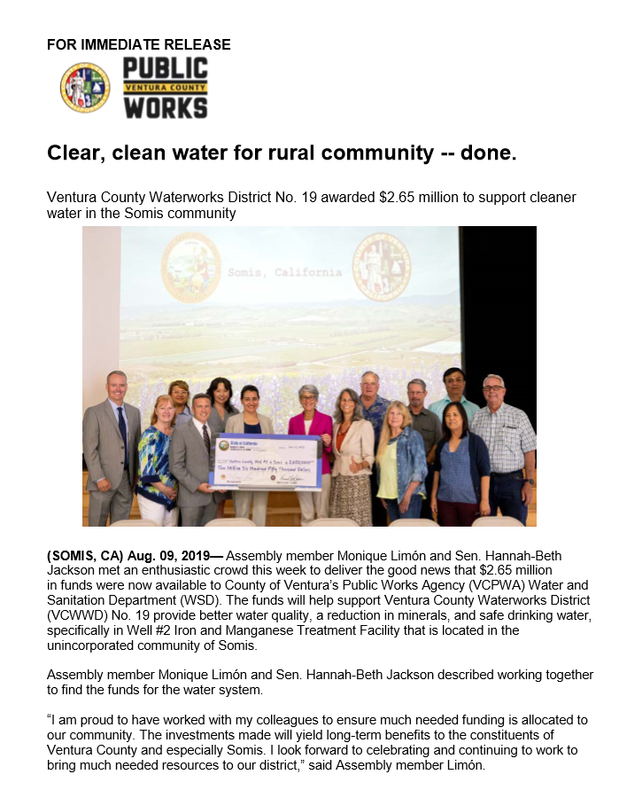

Slide 20
G. ADMINISTRATIVE UPDATE
An update on issues related to administration of the District including billing, charges, fees, programs, etc.
Notes:
V4 upgrade

Slide 21
H. BOARD LETTER TRACKER:​ AN UPDATE ON VENTURA COUNTY BOARD OF​ SUPERVISORS AGENDA ITEMS RELATED TO THE DISTRICT
A status report on what items the district may be presenting, or has recently presented, before the Ventura County Board of Supervisors​
Notes:
Board Letter Tracker info in JP master list

Slide 22
I. UPDATE ON THE AGRICULTURAL FOCUS GROUP
Staff holds bimonthly Agricultural Focus Meetings for customers of Districts 1 (Moorpark) and 19 (Somis)​
Notes:
Updates?

Slide 23
J. Budget and Financial Review
An update on the budget and financial status

Slide 24
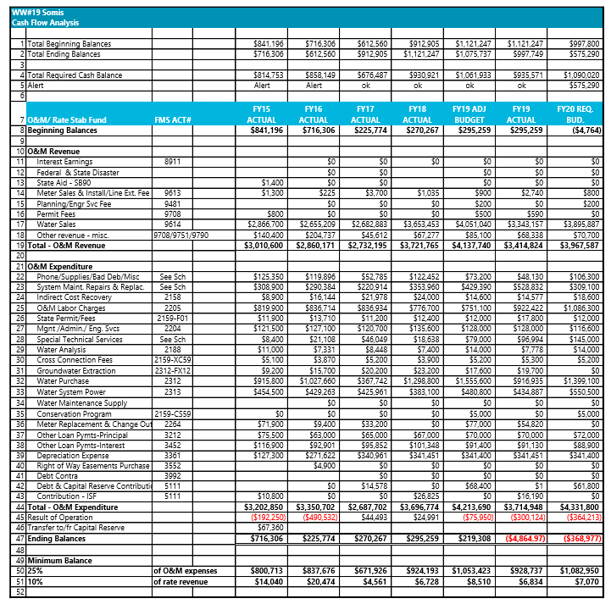
1. Budget and Financial Review

Slide 25
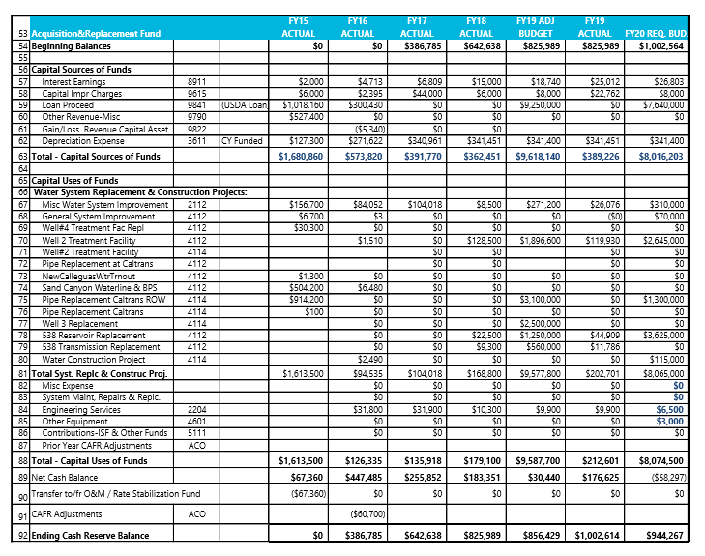
2. Budget and Financial Review

Slide 26
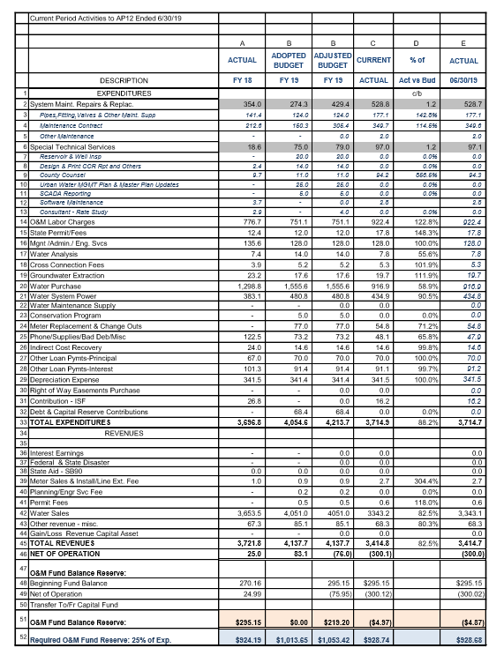
3. Budget and Financial Review

Slide 27
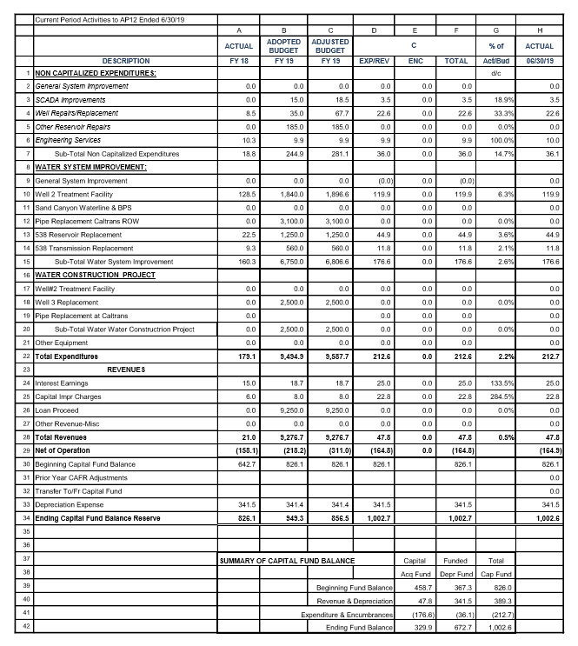
4. Budget and Financial Review

Slide 28
J. DIRECTOR’S INFORMATIONAL ITEMS​
Provides the opportunity for the Director to present items that are not within the subject matter of the District’s Staff Report.​
Notes:
Water Usage Graphs – included in handouts

Slide 29
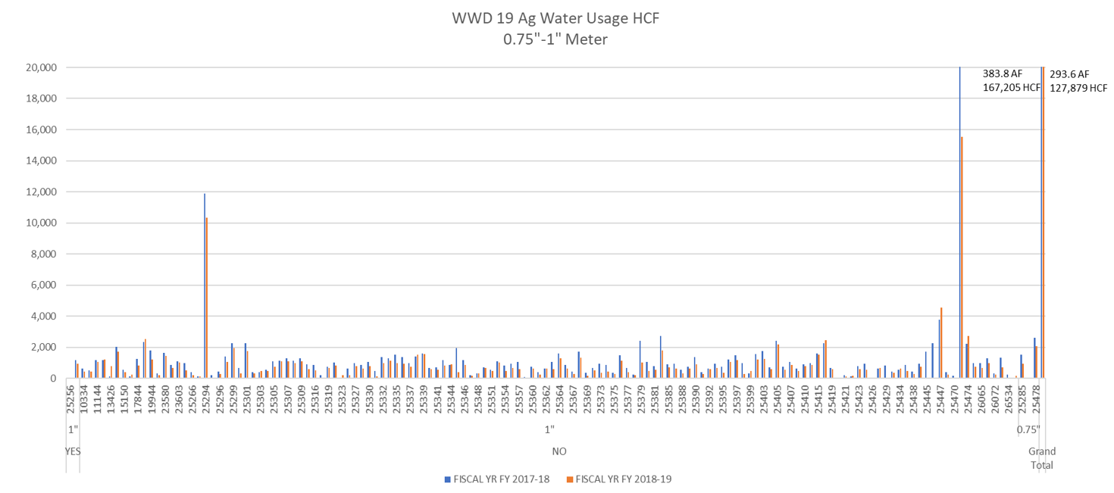
1. DIRECTORS ITEMS

Slide 30
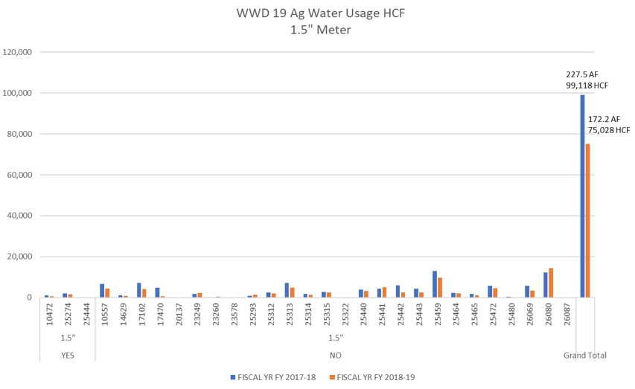
2. DIRECTORS ITEMS

Slide 31
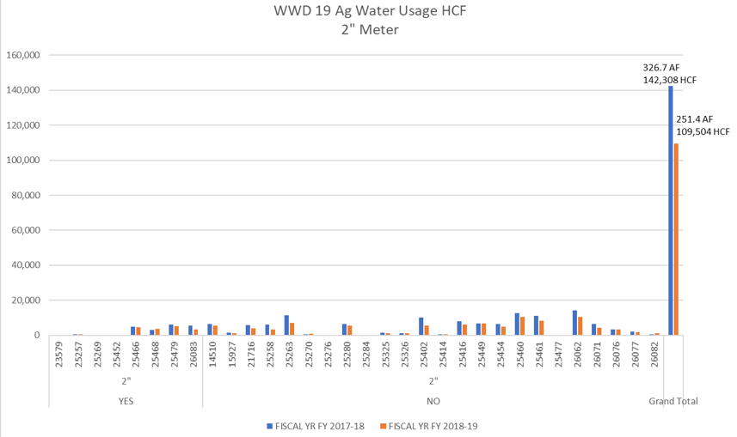
3. DIRECTORS ITEMS

Slide 32
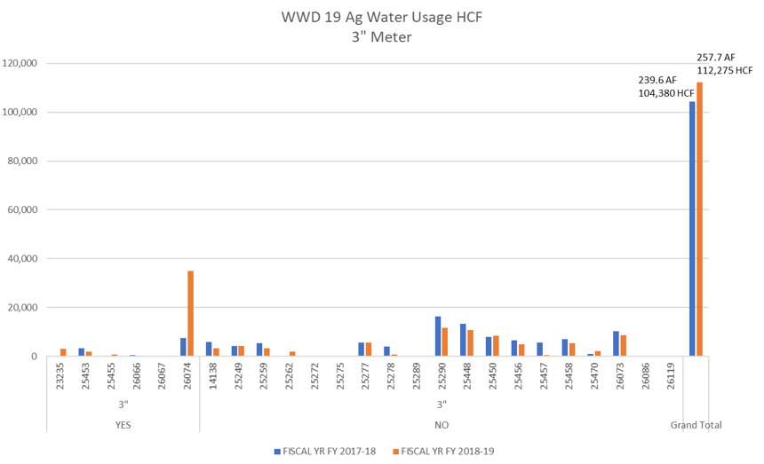
4. DIRECTORS ITEMS

Slide 33
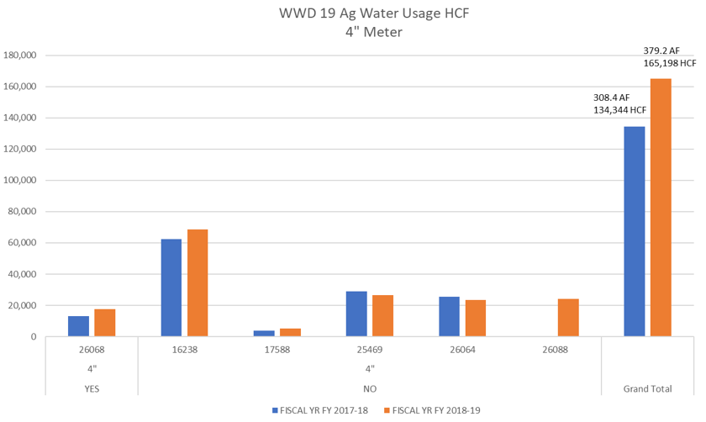
5. DIRECTORS ITEMS

Slide 34
6. DIRECTORS ITEMS
Districts 1 and 19
AMI Implementation Updates
Basic presentation on the overall cost savings possible for each district, and significant benefit for District & customer live use, still needs to be made to District 1 & 19 CACs.
Funding has already been included in the current FY20 W&S budget to complete installation of remaining AMI capable MXU radios, and related meters for both districts.
Funding has already been included in the current FY20 W&S budget for Sensus to complete installation of remaining AMI Base Station Antennas (3)
Intent is to go forward this with installation and implementation in FY20.
Full AMI implementation across the 4 districts will eliminate “2-systems” in use for monthly billing and addressing customer service issues.

Slide 35
5. COMMITTEE MEMBERS’ COMMENTS/FUTURE AGENDA ITEMS​ 6. ADJOURNMENT
Notes:
Comments –
Future Agenda Items -

Slide 36
Next WWD19 Meeting
October 17, 2019

